Slide 1


CAPSTONE PROJECT
Materials and mechanical projects
Presented By:
1. S. R Aarief Syed Ahamed-Solamalai College of Engineering-Mechanical Engineering

Slide 2
OUTLINE
○
Probelm Statement
Proposed Solution
System Approach
Algorithm & Deployment
Result
Conclusion
Future Scope
References
○ ○ ○ ○
○
○ ○

Slide 3
PROBLEM STATEMENT
The problem statement for materials and mechanical projects is to identify challenges in the aerospace industry, such as the need for lightweight, high-strength materials, and propose solutions through the development and testing of innovative materials for aircraft structures.

Slide 4
PROPOSED SOLUTION
Setting parameters:
Identifying the problem.
Researching and analyzing existing solutions.
Designing concepts and prototypes.
Selecting suitable materials.
Testing and validating the solution.
Implementing the finalized design.
Monitoring and optimizing performance.
Documenting and reporting findings.
Deploying and scaling the solution.
Continuously improving and adapting.
Output Parameters: (Measured)
Roughness (µm)
Tension (ultimate) Strenght (MPa)
Elongation (%)

Slide 5
SYSTEM APPROACH
Building the proposed solution would involve a combination of data processing,feature engineering,and machine learning. Here are the key system and library requriements.
System Requirements:
1.Hardaware:
A computer with sufficent processing power,perferably wwith multiple cores or a GPU for faster traning of machine learning models.
Adequate RAm to handke the size of the saraset and computational requriments.
2. Software:
An operating syatem compatible with the requrired machine learning libraries(eg., Windowa=s, linux,macsOS).

Slide 6
ALGORITHM & DEPLOYMENT
Python Programming Algorithm
A Python programming algorithm is a set of step-by-step instructions written in the Python programming language to solve a specific problem or perform a task. These instructions outline the logic and operations needed to achieve the desired outcome, such as sorting a list, finding the shortest path in a graph, or solving a mathematical equation. Algorithms can range from simple to complex and are fundamental building blocks in computer science and programming.
Steps to implement the PYTHON algorithm:
Testing
Optimization
Integration
Maintenance
Performance evaluation

Slide 7
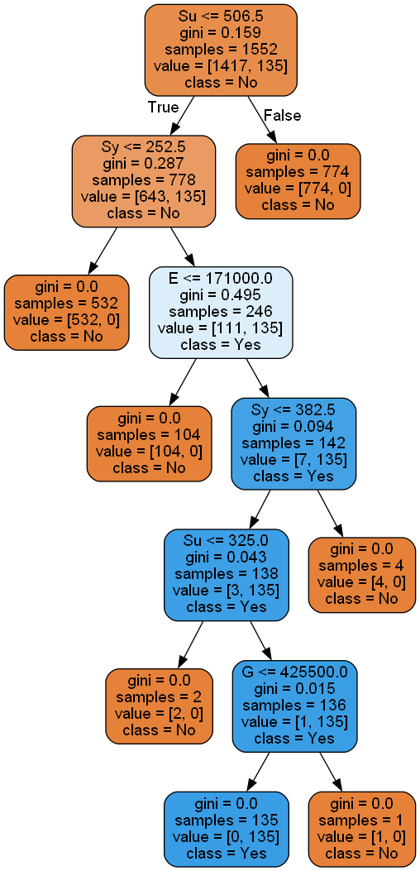
RESULT

Slide 8
CONCLUSION
Understanding materials and their mechanical properties is crucial for engineering and technology. Through this project, we explored different materials and their behaviors under stress. Looking forward, further research will lead to new materials and improved techniques, driving innovation in various industries.

Slide 9
FUTURE SCOPE
Advanced Materials Development: Continued research and innovation will lead to the creation of new materials with enhanced mechanical properties, such as increased strength, durability, and flexibility. Nanotechnology Integration: Exploration of nanomaterials and nanostructures will enable the development of materials with unique mechanical properties at the nanoscale, paving the way for applications in electronics, healthcare, and energy.

Slide 10
REFERENCES
https://www.kaggle.com/datasets/afumetto/3dprinter

Slide 11
THANK YOU

